Slide 1
Basic Understanding Of Version Control System
Version Control System

Slide 2
Version Control System
VCS stands for Version Control System.
It is a tool that helps developers manage changes to source code over time. VCS keeps track of modifications, allowing users to revert to previous versions, collaborate efficiently, and track changes made by different contributors.
Code is written as a series of functions or procedures that operate on data. Data is often passed around as arguments to these functions.

Slide 3
Types of Versions Controls
Local VCS
- Stores versions on a local machine (e.g., simple file backups).
Centralized VCS (CVCS)
- Uses a central server to store all versions (e.g., SVN, Perforce).
Distributed VCS (DVCS)
- Each user has a full copy of the repository (e.g., Git, Mercurial).

Slide 4
Local Version Controls
Local Version Controls refer to tools or systems used to manage changes to files and code on a single computer or local machine. They help developers keep track of modifications, revert to previous versions, and manage project history without needing internet access or a remote repository.

Slide 5
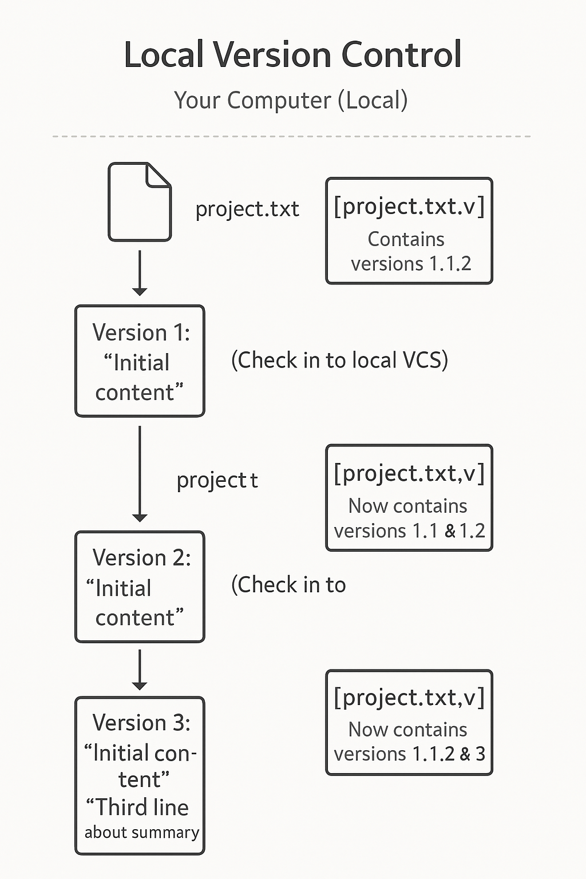
Local Version Controls

Slide 6
Centralized VCS
Centralized Version Control Systems (CVCSs) were created to help developers collaborate by storing all versioned files on a single central server. Clients check out files from this server, making it easy to manage and track project changes. Popular CVCSs include CVS, Subversion, and Perforce. This system provides better control and visibility over project updates, allowing administrators to manage permissions and making it more efficient than local version control systems.

Slide 7
Centralized VCS
Imagine you and your friends are working on a group project, and all your files are stored on one computer in the library. If anyone needs to make changes, they must first get the file from that computer, update it, and then save it back. This is how Centralized Version Control Systems (CVCSs) work. They use a central server to store all project files, and team members check out files from there. Examples of CVCSs include CVS, Subversion, and Perforce. This setup makes it easier for everyone to see updates, track changes, and control access.

Slide 8
Limitation of Centralized VCS
However, there’s a big problem—if the central computer (server) crashes, no one can access or save their work! If the hard drive gets damaged and there are no backups, all files and history could be lost. This is a serious risk because everything is stored in one place. That’s why newer systems, like Git, use Distributed Version Control Systems (DVCSs), where everyone has a copy of the full project on their own computer. This way, even if one system fails, the project is still safe.

Slide 9
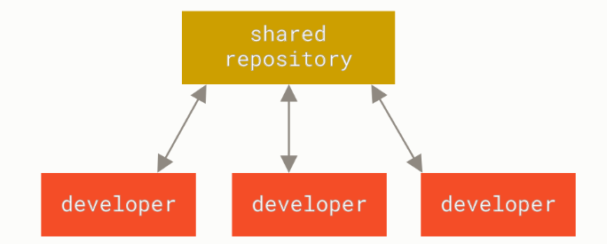
Centralized VCS

Slide 10
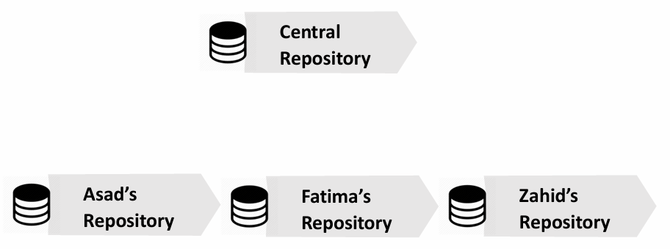
Centralized Version Controls

Slide 11
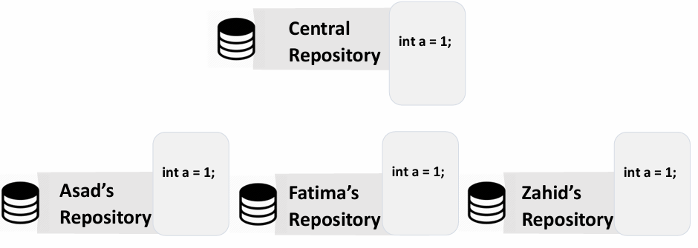
Centralized Version Controls

Slide 12
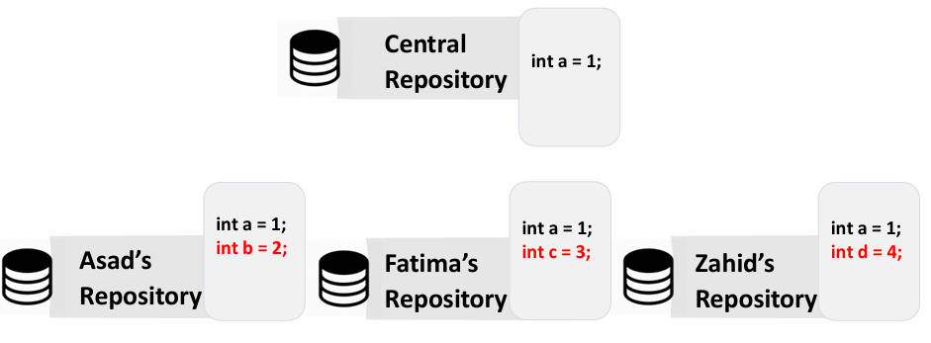
Centralized Version Controls

Slide 13
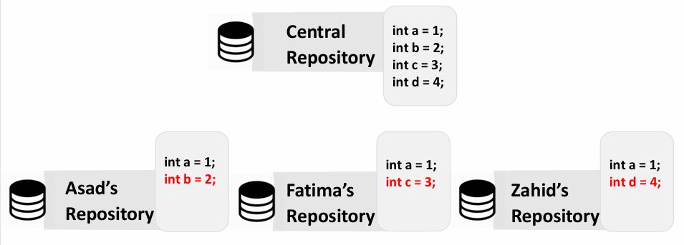
Centralized Version Controls

Slide 14
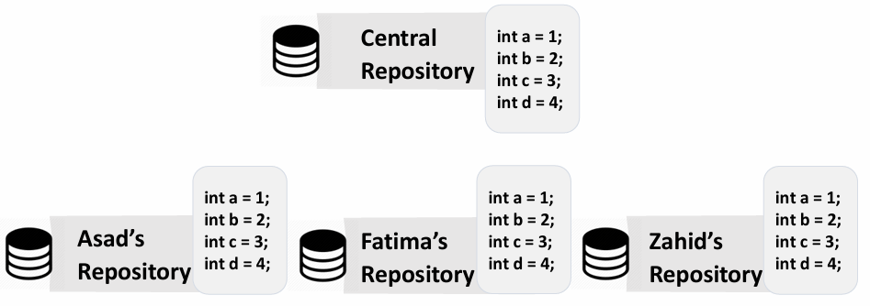
Centralized Version Controls

Slide 15
Distributed Version Control Systems
In Distributed Version Control Systems (DVCSs) like Git, Mercurial, and Darcs, instead of just downloading the latest version of files from a central server, every user gets a complete copy of the project, including its full history. This means each person has a full backup of the entire project on their own computer.

Slide 16
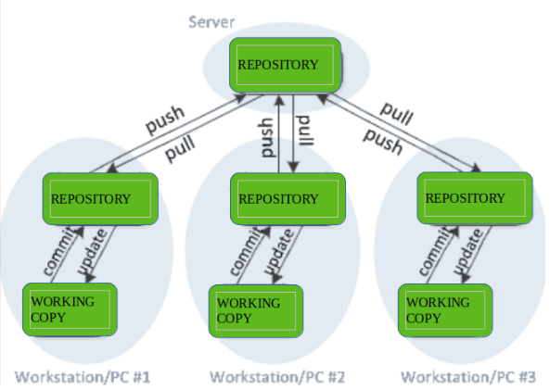
Distributed Version Control Systems

Slide 17
Distributed Version Control Systems
If the main server crashes or data is lost, the project is not gone. Any user with a copy can restore it by uploading their version back to the server. This makes DVCS much safer than Centralized Version Control Systems (CVCSs) because there is no single point of failure—the data is always available across multiple computers.

Slide 18
Difference
Feature | Centralized VCS (CVCS) | Decentralized/Distributed VCS (DVCS)
Structure | Single central server stores all versions. | Each user has a full copy of the repository.
Examples | SVN, Perforce, CVS | Git, Mercurial
Internet Requirement | Requires constant connection to the server. | Works offline; syncs when needed.
Performance | Slower, as every operation depends on the server. | Faster, as changes are made locally.
Collaboration | Developers must push/pull from the central server. | Developers can share changes peer-to-peer or push to a remote repository.

Slide 19

GitHub

Slide 20
GitHub
GitHub is a cloud-based platform that provides developers with tools to store, manage, collaborate on, and version-control their code using Git, a distributed version control system. It serves as a central hub for software development projects, enabling individuals and teams to work together efficiently, track changes, and maintain a history of their codebase. GitHub also offers features like issue tracking, pull requests, code reviews, and integrations with other development tools, making it a comprehensive platform for open-source and private projects alike

Slide 21
GitHub is a Cloud-Based Platform
GitHub is an online service that operates in the cloud, meaning it is accessible over the internet. Developers don’t need to set up their own servers or infrastructure to use GitHub. Instead, they can rely on GitHub’s servers to host their code and collaborate with others. This makes it easy to access projects from anywhere, at any time, using any device with an internet connection.

Slide 22
Repository
A repository, often referred to as a repo, is a centralized storage location where all the files, code, and the complete history of changes related to a project are stored. It is a core concept in version control systems like Git and platforms such as GitHub. Think of a repository as a digital folder or directory that houses everything related to a project source code, documentation, configuration files, and other assets. However, unlike a regular folder, a repository is equipped with advanced features that allow you to track every change made to the files over time. This includes details like who made the change, when it was made, and why it was made (through commit messages). Repositories also support branching, which enables developers to work on multiple versions of the project simultaneously, such as a stable main version and experimental feature versions. This makes repositories an essential tool for managing and organizing projects, especially in collaborative environments.

Slide 23
Repository
In addition to storing files and tracking changes, repositories facilitate collaboration among developers. They serve as a shared workspace where team members can contribute to the same project, even if they are working from different locations. For example, a remote repository hosted on platforms like GitHub allows developers to push (upload) their changes and pull (download) updates made by others. This ensures that everyone is working with the latest version of the code. Repositories also include tools like pull requests and code reviews, which allow team members to propose changes, discuss improvements, and ensure quality before merging updates into the main codebase. Whether the repository is local (on your computer) or remote (on a server), it acts as the backbone of modern software development, providing structure, history, and collaboration capabilities that make it easier to build, maintain, and scale projects.

Slide 24
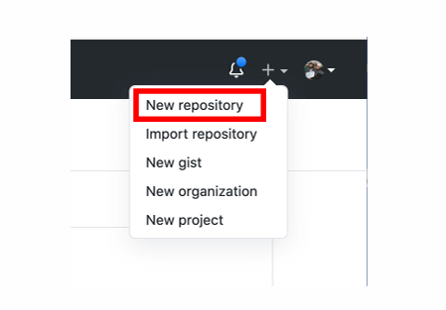
Create a repository on GitHub

Slide 25
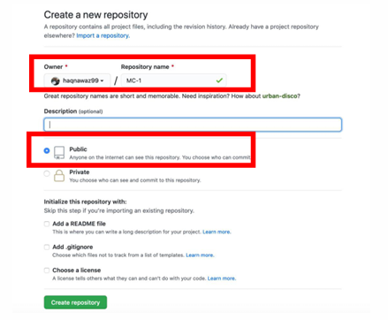
Provide details of repository on your account

Slide 26
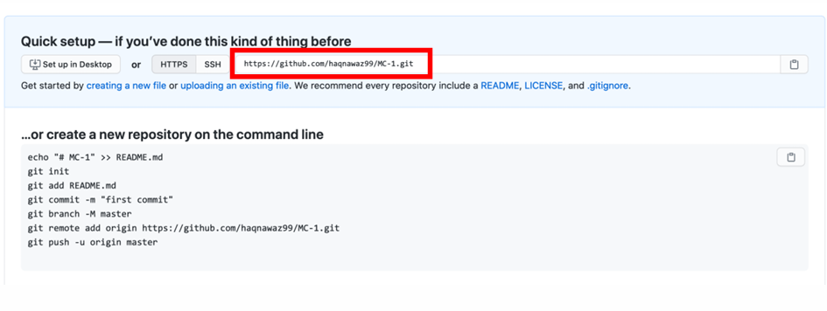
url of repository on your account

Slide 27
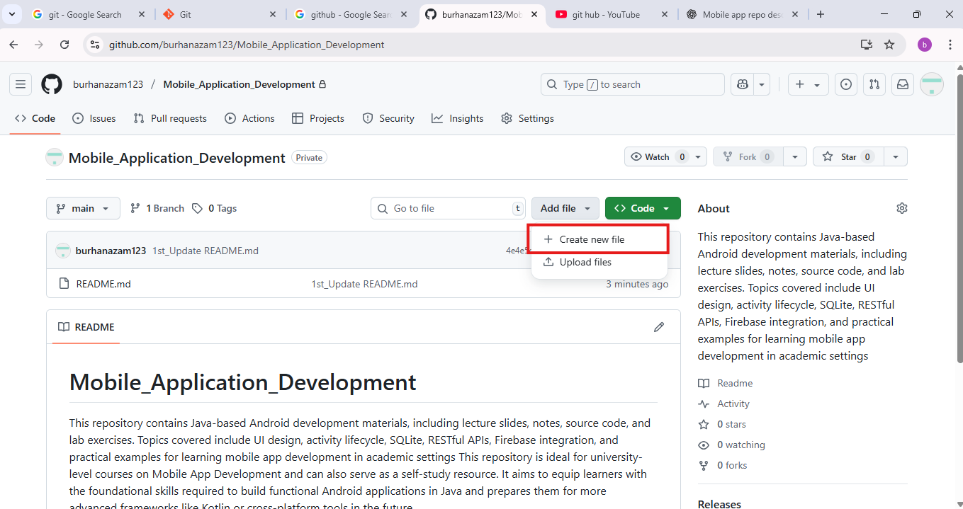
Creating a new file in GitHub Repo

Slide 28
Creating a new file in GitHub Repo
Open your repository.
Click the "Add file" button near the top-right.
Select "Create new file".
Enter the file name, including the folder path if needed (e.g., notes/Week1_Intro.md).
Add your content in the editor.
Scroll down, write a commit message (e.g., "Added Week 1 lecture notes").
Choose to commit directly to the main branch or create a new branch.
Click "Commit new file".

Slide 29
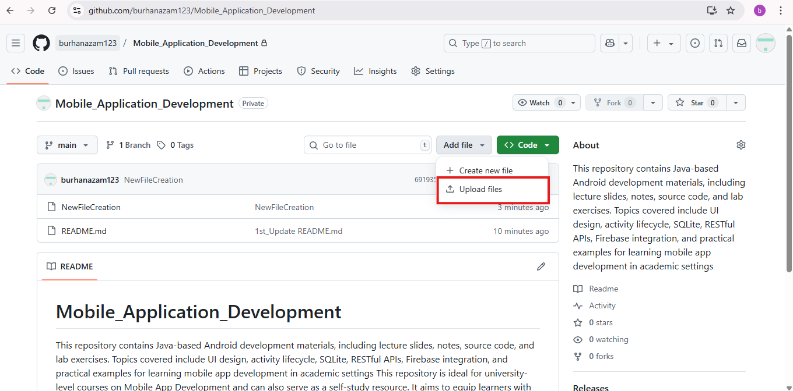
Uploading a new file in GitHub Repo

Slide 30
Uploading a new file in GitHub Repo
Using GitHub Web Interface (Easiest Way)
Go to your GitHub repository in your browser.
Click the "Add file" dropdown (top right).
Choose "Upload files".
Click "Choose your files" or drag-and-drop the file from your computer.
Scroll down and write a commit message (e.g., "Uploaded Lecture 1 slides").
Click "Commit changes".

Slide 31
Git Clone
git clone is a fundamental Git command that allows you to create a local copy of a remote repository.
It downloads all the files, branches, and commit history, setting up a local environment where you can work on the project.
git clone <repository-url>
<repository-url>: The URL of the remote repository you want to clone. This can be an HTTPS, SSH, or Git protocol link.

Slide 32
Git add
git add is a crucial command in Git that stages changes in your working directory for the next commit. It allows you to selectively choose which changes to include, helping you create organized and meaningful commits. By using git add, you prepare your changes for the staging area, making it easier to review and commit them to the repository's history.
git add <filename.txt>
git add .

Slide 33
git commit
git commit is a command in Git, the version control system, that saves the changes you've staged (using git add) to the repository's history. It creates a permanent snapshot of your project at that point in time, along with a message describing what changes were made and why. Each commit acts as a checkpoint that you can return to later if needed.
Git Command
git commit -m "Your commit message here"

Slide 34
git push
git push is used to upload local commits to a remote repository (e.g., GitHub, GitLab, Bitbucket). It updates the remote branch with the latest changes from your local repository.
Git Command
git push origin main

Slide 35
Git WorkFlow
git clone # makes a clone
git add . # Stage changes
git commit -m "Updated feature" # Commit changes
git push origin <main> # Push to remote repo

Slide 36
Branching
In Git, "branching" refers to the process of creating a separate, parallel line of development within a repository, allowing developers to work on different features or bug fixes without affecting the main codebase, essentially creating a "copy" of the project at a specific point in time to work on independently before merging changes back into the main line later on.

Slide 37
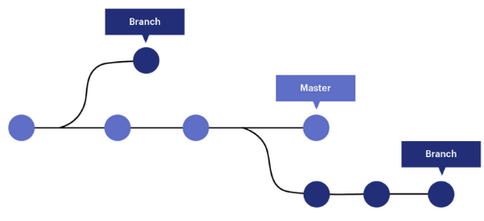
Branching

Slide 38
Branching and Merging
Merging in Git means combining changes from one branch into another.
For example, if you have a feature branch where you made some updates and want to bring those changes into the main branch, you use a merge.
For Merging You will Use the Pull Request

Slide 39
Cheat Sheet
git –version (to check the git version)
git config –global user.name Burhan (Configurational Settings)
git config –global user.email burhan.azam@gmail.com (Configurational Settings)
git config –list (To check all the configuration)
git clone” Repo name”
git status (tells us about the status of the Repository)

Slide 40
Cheat Sheet
git add File_name.txt
git commit -m "First commit using bash"
git init (For the initialization)
git remote add origin https://github.com/burhanazam123/TestRepo.git
git branch (To check in which branch we are)
git branch -M main (To rename)
git push origin main
git checkout –b Branch name
git pull origin main

